Slide 1
data science with python
Preparing the Data tables

Slide 2
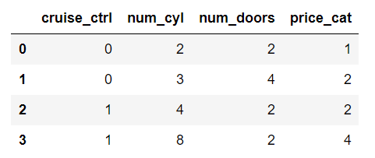
What is data?
Data is held in TABLES, DATASETS
Collections of objects defined by attributes
Attributes are also called
Features
Variables
Field
Predictors
characteristics
An attribute is a property of an object
Example : num_doors, price_cat etc
A collection of attributes describe an object
Other names
Record, samples, point, case, entity, instance, entry
Document (mongodb)
Data science a study of 3 or 4 different disciplines. Hence there are a lot of vocab, often many for the same term!

Slide 3
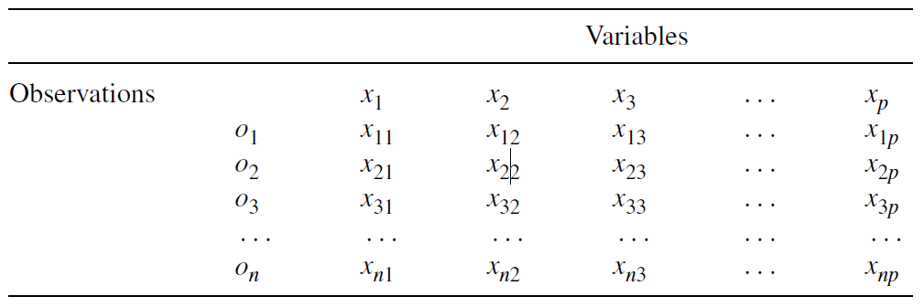
OBSERVATIONS AND VARIABLES
Every discipline from biology and economics to engineering and marketing measures, gathers, and stores data in some digital form
The data are organized into a table for data analysis where each row, referred to as an observation
Each of columns defining the table are called ‘attributes’
When an attribute is thought of as a set of values describing some aspect across all observations, it is called a variable
Know the type of variables

Slide 4
features
Each feature has a set of values a record draw from
In machine learning and pattern recognition, a feature is an individual measurable property or characteristic of a phenomenon being observed.
Choosing informative, discriminating and independent features is a crucial step for effective algorithms in pattern recognition, classification and regression.

Slide 5
TYPES OF features
Type of variable | What is it?
discrete variable | variable contain a fixed number of distinct values. Represented in terms of integers E.g. (number of kids, cars, pets, PIN Code, click counts, word counts in documents)
continuous variable | is a numeric variable synonymous for Quantitative Real /floating numbers E.g. (height, age, temperature, oxygen level, etc..)
ordinal variable | Is a categorical variable that can be ranked (grades, T-shirt size, levels of satisfaction)
nominal variable | Is a categorical variable that can't be ranked (race, religion, sex, Industry) Nominal is synonymous for Categorical and Qualitative
Dichotomous/ binary | contains only 2 values. E.g. the values of a variable Gender may only be “male” or “female.” A binary variable is a widely used dichotomous variable with values 0 or 1. E.g. a variable Purchase may indicate 0 to indicate that a customer did not buy and 1 to indicate that they did buy;
Reference Numbers, ID columns | not used directly in data analysis, may be helpful for preparing data tables or interpreting the results

Slide 6
feature types
Dependent and Independent Variables
An independent variable, sometimes called an experimental or predictor variable, is a variable that is being manipulated in an experiment in order to observe the effect on a dependent variable, sometimes called an outcome/response/target variable.
Dependent Variable: Test Mark (measured from 0 to 100)
Independent Variables: Revision time (measured in hours), Intelligence (measured using IQ score)

Slide 7
feature type - Categorical
Categorical variables are also known as discrete or qualitative variables.
Categorical variables can be further categorized as either
nominal,
ordinal or
dichotomous.

Slide 8
feature type - Categorical
Nominal variables are variables that have two or more categories, but which do not have an intrinsic order.
For example, a real estate agent could classify their types of property into distinct categories such as houses, condos, co-ops or bungalows.
So "type of property" is a nominal variable with 4 categories called houses, condos, co-ops and bungalows.

Slide 9
feature type - Categorical
Dichotomous variables are nominal variables which have only 2 categories or levels.
For example, if we were looking at gender, we would most probably categorize somebody as either "male" or "female". This is an example of a dichotomous variable (and also a nominal variable).
Another example might be if we asked a person if they owned a mobile phone. Here, we may categorize mobile phone ownership as either "Yes" or "No".
In the real estate agent example, if type of property had been classified as either residential or commercial then "type of property" would be a dichotomous variable.

Slide 10
feature type - Categorical
Ordinal variables are variables that have two or more categories just like nominal variables
the categories can also be ordered or ranked.
Survey: Do you like the policies of NDA government, the responses may be
"Not very much",
"They are OK" or
"Yes, a lot" .
you can rank them from the
most positive ( Yes, a lot)
middle response (They are OK)
least positive (Not very much).
However, whilst we can rank the levels, we cannot place a "value" to them; we cannot say that "They are OK" is twice as positive as "Not very much"

Slide 11
feature type - Continuous
Interval variables are variables for which their central characteristic is that they can be measured along a continuum and they have a numerical value
(for example, temperature measured in degrees Celsius or Fahrenheit). So the difference between 20C and 30C is the same as 30C to 40C. However, temperature measured in degrees Celsius or Fahrenheit is NOT a ratio variable.
Ratio variables are interval variables, but with the added condition that 0 (zero) of the measurement indicates that there is none of that variable.
So, temperature measured in degrees Celsius or Fahrenheit is not a ratio variable because 0C does not mean there is no temperature. However, temperature measured in Kelvin is a ratio variable as 0 Kelvin (often called absolute zero) indicates that there is no temperature whatsoever.
Other examples of ratio variables include height, mass, distance and many more.
The name "ratio" reflects the fact that you can use the ratio of measurements. So, for example, a distance of 10 meters is twice the distance of 5 meters.

Slide 12
Types of data sets
Dataset Type | Characteristics | Example
File | a single file | text file, dat/csv
Folder | a set of files in a single folder
Database | a database | Oracle/ Cassandra/ mongodb/MySQL
Web | an Internet site | Web Feature Service (WFS)
Dataset type dictates
the type of pre-processing steps we need to take.
Tools we would need etc

Slide 13
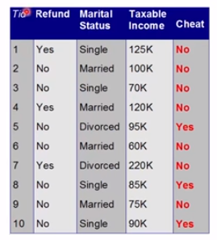
Record data
Collection of records
Each consists of fixed set of attributes/features
Refund … what type of feature?
Marital Status ?
Taxable income?
Cheat ?

Slide 14
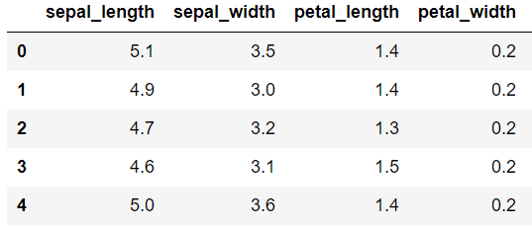
Data matrix
Objects with only numeric attributes can be represented by m x n matrix, m = number of rows, n = number of features
Such data objects can be thought of as ‘points’ in a multi-dimensional space, where each dimension = a feature
Many machine learning algorithms require us represent data in the form of a data matrix

Slide 15
Document data
Commonly used in text analytics
Associated with UNSTRUCTURED text
Each document (a record) becomes a “term” vector
Consisting of many ‘terms’
Typically called ‘document term matrix’ (dtm)
Each ‘term’ represents a feature in the input document
The value of each term is the number of times the corresponding feature appears in the document
1 2 3 4 | “It was the best of times” = [1, 1, 1, 1, 1, 1, 0, 0, 0, 0] "it was the worst of times" = [1, 1, 1, 0, 1, 1, 1, 0, 0, 0] "it was the age of wisdom" = [1, 1, 1, 0, 1, 0, 0, 1, 1, 0] "it was the age of foolishness" = [1, 1, 1, 0, 1, 0, 0, 1, 0, 1]

Slide 16
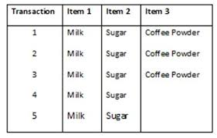
Transaction data
A record involves a set of items
E.g. grocery store : a customer purchasing all items → constitutes a TRANSACTION

Slide 17
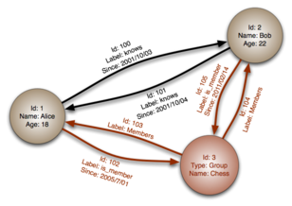
Graph data
It is a set of objects, either a node or an edge.
Nodes - entities or instances such as people, businesses, accounts, or any other item to be tracked.
equivalent of the record,
Edges, representing the relationship between them.

Slide 18
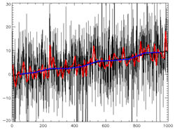
Time series data
A time series is a series of data points indexed (or listed or graphed) in time order.
Most commonly, a time series is a sequence taken at successive equally spaced points in time.
Examples of time series are heights of ocean tides, counts of sunspots, and the daily closing value of the Dow Jones Industrial Average.
Time series are very frequently plotted via line charts.
used in signal processing, pattern recognition, econometrics, mathematical finance, weather forecasting, earthquake prediction, electroencephalography, control engineering, astronomy, communications engineering

Slide 19
Data quality
Usually overlooked, surprisingly ☹
Data czars, architects, analysts → DATA ENGG team plays an important role
Good data quality ensures a good ‘data product’
Keys data quality areas
Noise and outliers
Missing values
Duplicate data
Early exploration should address the above (detect and mitigate)

Slide 20
Noise and outliers
Noise –
irrelevant data
invalid data points
well nature of universe though ☹
Outliers
may not always be invalid, mostly valid.
Why important for DS/ML?
Skewed results with machine learning models using distance based computations

Slide 21
Missing values
Information not collected
Feature may not be applicable to all business cases
Many ways to handle missing values
Why important for DS/ML?
Most machine learning models do not allow missing values in the datasets

Slide 22
Duplicate data
Duplicate records, doubles, redundant data, duplicate rows
Multiple sources of data
Data integration may lead to duplicate data
Often this requires skills data engg team to clean up the data
Why important for DS/ML?

Slide 23
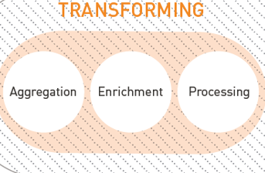
PREPARING DATA TABLES
Preprocessing or data wrangling
Preparing the data is one of the most time-consuming parts of a data analysis/data mining project.
Typical types of preprocessing
Aggregation
Sampling
cleaning
Feature Engineering
Feature selection
Feature extractions
Dimensionality reduction
LDA/SVD
Feature creation
Discretization & binarization
Attribute transformations
Many techniques
But we do not apply all of ‘em, always (no need to)
** imp **
Not all of these activities are independent
Overlap possible

Slide 24
activities
CLEANING THE DATA
TRANSFORMATION
REMOVING OBSERVATIONS AND VARIABLES
NEW FREQUENCY DISTRIBUTION
CONVERTING TEXT TO NUMBERS
CONVERTING CONTINUOUS DATA TO CATEGORIES
COMBINING VARIABLES
GENERATING GROUPS
PREPARING UNSTRUCTURED DATA
SAMPLING THE DATA
AGGREGATION OF DATA

Slide 25
aggregation
Domain specific data – needs different treatment
Many tools – integration
ETL tools
Databases (MYSQL, Oracle, NOSQLs etc)
Python - PANDAS

Slide 26
sampling
Is the main technique for data selection
Used for pre-liminary investigation and final data analysis
Statisticians sample because obtaining the entire set of data is too expensive or time consuming
Data scientists sample because processing the entire set of data is too time taking
Facebook, twitter, google blogs – generate tera bytes of data every hour
Cannot process all of the data even with 1000s of computing resources
Key principle – sample should be representative of a business cycle
Very subjective
Varies from domain and projects

Slide 27
Types of sampling
Simple random sampling
Stratified sampling
Sampling with replacement
Objects are not removed from the population as they are selected for the sample
Sampling without replacement
Objects are removed from the population as they are selected for the sample

Slide 28
CLEANING THE DATA
Diligence | Comments
nominal or ordinal scale (where there are a fixed number of possible values) | inspect all possible values to uncover mistakes, duplications and inconsistencies. variable Company may include a number of different spellings for the same company such as “General Electric Company,” “General Elec. Co.,” “GE,” “Gen. Electric Company,” “General electric company,” and “G.E. Company.”
Numeric variables with inclusion of nonnumeric terms. | a variable generally consisting of numbers may include a value such as “above 50” or “out of range.”
entries with missing data | (1) remove the entire observation from the data table; (2) remove the variable (containing the missing values) from the data table; (3) replace the missing value manually; (4) replace the value with a computed value, for example, the variable’s mean or mode value (5) replace the entry with a predicted value based on a generated model using other fields in the data table.

Slide 29
CLEANING THE DATA
Diligence | Comments
values within the data tables are incorrect | Outliers in the data may be errors calculate z-score for each value that represents the number of standard deviations the value is away from the mean. Values greater than plus or minus 3 may be considered outliers. plotting the data using a box plot or a frequency histogram Using pandas to detect outliers Other methods, such as clustering and regression models can also be useful to identify anomalous observations -

Slide 30
CLEANING THE DATA
Diligence | Comments
Timeliness of data | how up-to-date the observations are and whether the quality is the same across different sources of data.
Data been collected over time | changes related to the passing of time may no longer be relevant to the analysis. Cost of production field - collected over many years, the rise in costs attributable to inflation may need to be considered for the analysis.

Slide 31
Transformation
Transformation
Creating Dummy Variables | A variable measured on a nominal or ordinal scale is usually converted into a series of dummy variables for use within data mining methods that require numbers. Each category is usually converted to a variable with 1 of 2 values: a 1 when the value is present in the observation and a 0 when it is absent. The method would generate a new variable for each category, With methods, such as multiple linear regression or logistic regression - these methods are sensitive to collinearity and hence including all variables – cause high variance If the final variable can be deduced from the other variables … E.g the variable color whose values are black, white and red could be translated into 3 dummy variables, one for each of the 3 values. Since the red column can be derived from the other two columns, only black and white columns are needed.

Slide 32
Transformation
Transformation
Create Bins for Continuous Variables | For example, a variable temperature with values ranging from 0 to 100, may be divided into a series of bins: 0–10, 10–20, and so on.
COMBINING VARIABLES | Merge, join, concatenate
Scaling/Standardizing the Variables to a Consistent Range: | In order to treat different variables with the same weight, a scheme for normalizing the variables to the same range is often used, such as between zero and one. Min–max, z-score, and decimal scaling
Calculating Terms to Enhance Prediction | certain variables may be combined, or the variables may be transformed using some sort of mathematical operation. May allow more accurate modeling of nonlinear relationships. Some commonly used mathematical operations include square, cube, and square root.
Mapping the Data to a Normal Distribution | take the log, exponential, or a Box–Cox transformation

Slide 33
Why scale?
most machine learning algorithms take into account only the magnitude of the measurements, not the units of those measurements.
one feature, expressed in a very high magnitude (number), may affect the prediction a lot more than an equally important feature.
2 lengths, l1 = 250 cm and l2 = 2.5 m.
humans see these 2 are identical lengths (l1 = l2), but most ML algorithms interpret this differently.
more weight to l1, just because it is expressed in a larger number , which, in turn is going to have a much larger impact on the prediction than l2.
Certain types like Naive Bayes, Decision Trees, RF and XGB do not require feature scaling
The algorithms that exploit distances or similarities (e.g. in form of scalar product) between data samples, such as k-NN and SVM, often require feature scaling.

Slide 35
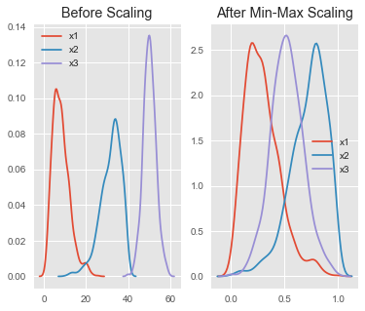
Min-Max Scaler
The Min-Max Scaler uses the following formula for calculating each feature:
(xi–min(x))/ (max(x)–min(x))
It transforms the data so that it’s now in the range specified.
Note that, by default, it transforms the data into a range between 0 and 1 (-1 and 1, if there are negative values).
Sensitive to outliers
used as an alternative to The Standard Scaler or when the data is not normally distributed.

Slide 36
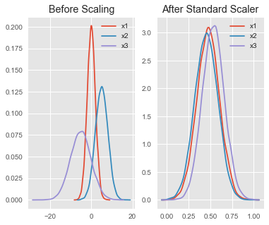
Standard Scaler
most widely used
assumes that your data follows a Gaussian distribution
mean and the standard deviation are calculated for the feature and then the feature is scaled based on:
(xi–mean(x))/ stdev(x)
The idea behind Standard Scaler is that it will transform your data, such that the distribution will have a mean value of 0 and a standard deviation of 1
Sensitive to outliers
If the data is not normally distributed, it’s not recommended to use the Standard Scaler.

Slide 37
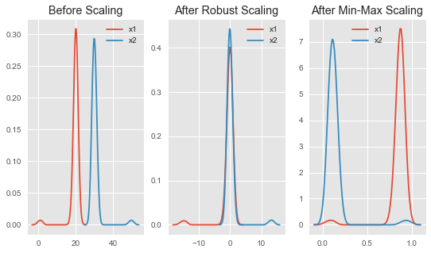
Robust Scaler
The Robust Scaler uses statistics that are robust to outliers:
(xi–Q1(x))/( Q3(x)–Q1(x)) , for each feature.
removes the median and uses the interquartile range. Q1 and Q3 represent quartiles.
usage of interquartiles means focus on the parts where the bulk of the data is.
This makes them very suitable for working with outliers.
after Robust scaling, the distributions are brought into the same scale and overlap, but the outliers remain outside of bulk of the new distributions.
Min-Max scaling, the two normal distributions are kept separate by the outliers that are inside the 0 –1 range.

Slide 38
CLEANING THE DATA – time series
Diligence | Comments
values within the data tables are incorrect | Data Smoothing - The use of an algorithm to remove noise from a data set, allowing important patterns to stand out. random walk, moving average, Exponential smoothing assigns exponentially more weight, or importance, to recent data points than to older data points. Simple : used when the time series data has no trend and no seasonality. Linear : used when the time series data has a trend line. Seasonal: used when the time series data has no trend but seasonality.

Slide 39
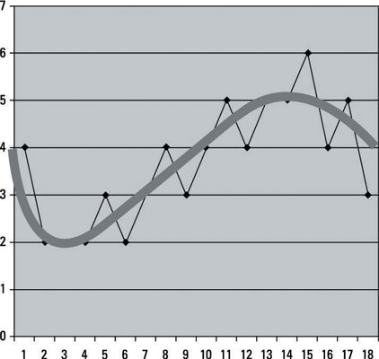
Data smoothing
Data smoothing is to find the “signal” in the “noise”
By discarding data points that are considered “noisy”.
The idea is to sharpen the patterns in the data and highlight trends the data is pointing to.
The data consists of 2 parts:
1st part (core data points) - signifies overall trends or real trends,
2nd part - mostly of deviations (noise)
Data smoothing seeks to eliminate that 2nd part

Slide 40
CLEANING THE DATA - Data Smoothing
advantages | disadvantages
It’s easy to implement. | It may eliminate valid data points that result from extreme events
It helps identify trends. | may lead to inaccurate predictions if the test data is only seasonal and not fully representative
It eliminates data points that you’ve decided are not of interest. | may be vulnerable to significant disruption from outliers within the data
It helps predict the general direction of the next observed data points.
It generates nice smooth graphs.
compare smoothed graphs to untouched graphs
Data points removed during data smoothing may not be noise; they could be valid, real data points that are result from rare-but-real events.
Data smoothing can be helpful in moderation, but its overuse can lead to a misrepresentation of data.

Slide 41
REMOVING OBSERVATIONS AND VARIABLES
Diligence | Comments
feature selection | large number of variables can present a number of issues including the problems of over fitting Domain experts can help variables that are not relevant to the problem Variables that contain the same value for almost all observations do not provide much value examining the relationships between the variables there should be little relationship between the variables (predictors) Strong relationships between the independent variables and the response variables are important Use Bivariate data visualizations, such as scatterplot matrices Calculating a correlation coefficient for each pair of continuous variables
feature extraction | Techniques, such as principal component analysis, can be used to reduce the number of continuous variables LDA/SVD

Slide 42
Transformation
CONVERTING TEXT TO NUMBERS
To use variables that have been assigned as nominal or ordinal and described using text values within certain numerical analysis methods, it is necessary to convert the variable’s values into numbers.
For example, a variable with values “low,” “medium” and “high” may have
“low” replaced by 0
“medium” replaced by 1
“high” replaced by 2

Slide 43
GENERATING GROUPS - clustering
Generally, larger data sets take more computational time to analyze and creating subsets from the data can speed up the analysis.
Another reason for creating subsets is when a data set that has been built up over time for operational purposes, but is now to be used to answer an alternative business research question.
One approach - random subset which is effective where the data set closely matches the target population.

Slide 44
PREPARING UNSTRUCTURED DATA
In many disciplines, the focus of a data analysis or data mining project is not a simple data table of observations and variables.
For example, in the life sciences, the focus of the analysis is genes, proteins, biological pathways, and chemical structures.
In other disciplines, the focus of the analysis could be documents, web logs, device readouts, audio or video information, and so on.

